Slide 1
Servlet
Java Serverside Programming Technology

Slide 2
Objectives
Concept of static page and dynamic page.
Different Server side technologies.
What is a Servlet and its advantages.
Servlet API
Lifecycle of a servlet
How to create a new webapplication project and servlet in NetBeans.
GET vs POST
RequestDispatcher
sendRedirect
Accessing database from Servlet.
SingleThreadModel
About Deployment Descriptor ( web.xml )

Slide 3
Servlet Definition
A Java program, running in a Internet server, that generates web content dynamically depending on the content of a request from a client

Slide 4
Static Page
A web page that is not modified by an application /webserver before the page is sent to a browser.
Static pages exist in server before client makes a http request.

Slide 5
Dynamic Page
An HTML page generated on the fly by a server side program as a result of a request for data.
Dynamic pages doesn’t exist in server before client makes a http request.

Slide 6
Need for Serverside Programming
We need a server side program to process the submitted data on server side.
Ex:- User enters data in a registration form designed in HTML and submits, then the submitted data needs to be processed on server side, like storing data into a database table and unique registration id needs to be displayed back to the new user. In this case we need some helper program sitting on server side and in which we implement processing logic.
We need a server side program to generate dynamic web pages which publish data to the users.
Ex:- Web pages Display Employee Details by taking EMP_ID as input.

Slide 7
Serverside programming Technologies
Common Gateway Interface ( CGI )
ColdFusion(Allaire )
Active Server Pages ( ASP )
Server Side JavaScript
Personal Home Page tools( PHP )
Java Servlets
Java Server Pages ( JSP )

Slide 8
CGI
The Common Gateway Interface (CGI) is a standard protocol that defines how webserver software can delegate the generation of webpages to a console application. Such applications are known as CGI scripts; they can be written in any programming language, although scripting languages are often used.
A CGI script is a program written in one of several popular languages such as Perl, PHP, Python, etc. that can pass data between a web page and programs on the web server. CGI scripts are widely used to process forms such as search boxes.
An application written in a programming language (often in PERL) used to create interactive and dynamic web pages. It has multiple purposes; it is often used to process the data entered by a visitor into a form, to search web pages, send newsletters, create polls and guest books.

Slide 9
Advantages of CGI
It has been widely used for implementing dynamic generated pages on the Web. One advantage of CGI programs is that they are language independent .
CGI programs can be written in any language that allows one to write normal programs since they are executed in the same way as the normal programs. Another advantage of CGI is that it's a very simple interface.
It's not necessary to have any special library to create a CGI program, or write programs using a particular API. Instead, CGI programs rely on the standard concepts of standard input, standard output, and environment variables to communicate with the Web server.

Slide 10
Disadvantages of CGI
CGI programs are slow since they need to fork a new process for every HTTP request and the database connection must be reopened for the next instance of the program, which is quite costly

Slide 11
Advantages of Servlets
One of the key advantage of a Servlet is Multithreading based service.
It provides service to the client using a thread.
Server doesn’t create a new process for each http request for a servlet received from a client. Instead ,it create's a new dedicated thread for each new request comes from the client and kills the thread after sending response back to the client.
So using multithreading concept one servlet object can serve different client requests Simultaneously. Server doesn’t create multiple servlet objects for serving multiple client request.
Portability
Secured
Extensibility and Flexibility

Slide 12
Servlet API
javax.servlet .* (package )
interfaces
Servlet
ServletRequest
ServletResponse
RequestDispatcher
SingleThreadModel
ServletConfig
ServletContext
Filter
FilterConfig
FilterChain
classes
GenericServlet
ServletInputStream
ServletOutputStream
ServletException

Slide 13
Servlet API
javax.servlet .http.* (package )
Interfaces
HttpSerlvetRequest
HttpServletResponse
HttpSession
Classes
Cookie
HttpSerlvet

Slide 14
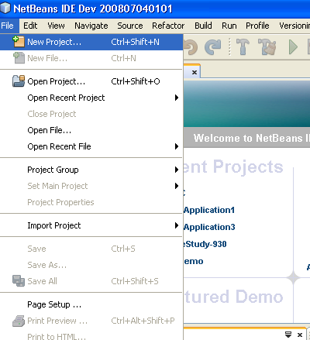
Steps for Creating a Java Web application in NetBeans IDE
1.Click on File Menu and select NewProject Option.

Slide 15
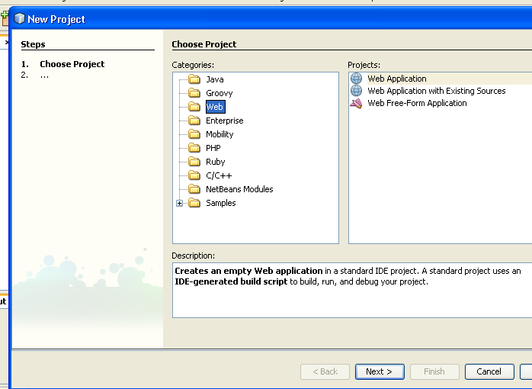
Steps for Creating a Java Web application in NetBeans IDE
2. Select the Web as Category, Webapplication as projects and click next button.

Slide 16
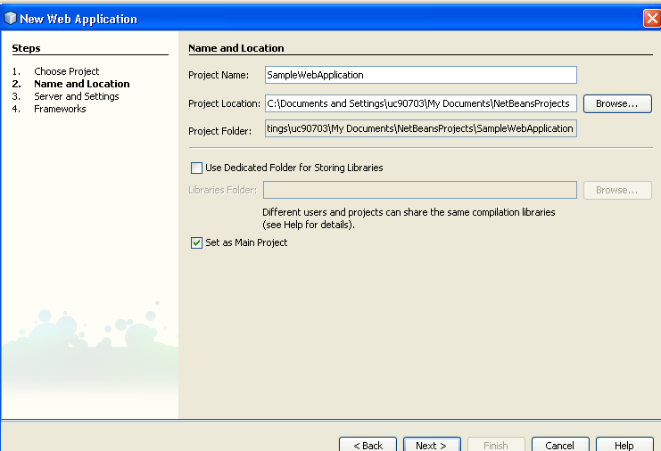
Steps for Creating a Java Web application in NetBeans IDE
3. Specify project name and click next button

Slide 17
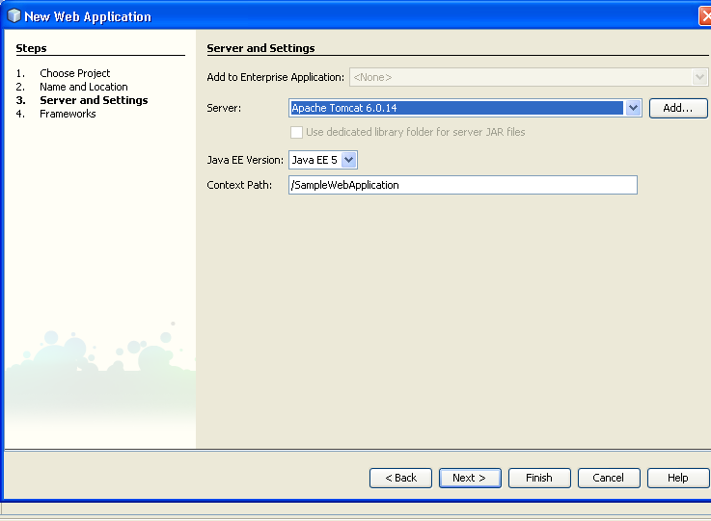
Steps for creating a Web application in NetBeans IDE
4. Select the Server and click on finish button

Slide 18
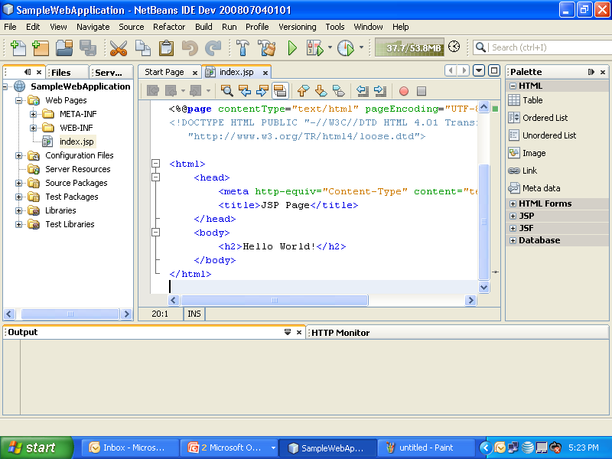
Output Screen after creating a new web application in NetBeans

Slide 19
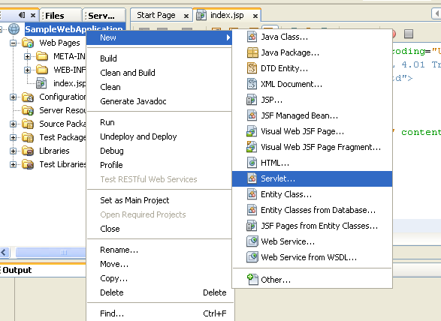
Steps for Creating a new Servlet
1. Right click on Project , select New and then select Servlet option.

Slide 20
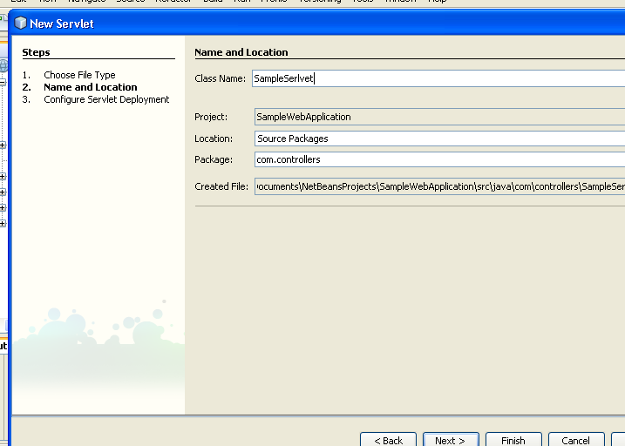
Steps for creating a new Servlet
2. Specify the Servlet class name ,its package and press Next button.

Slide 21
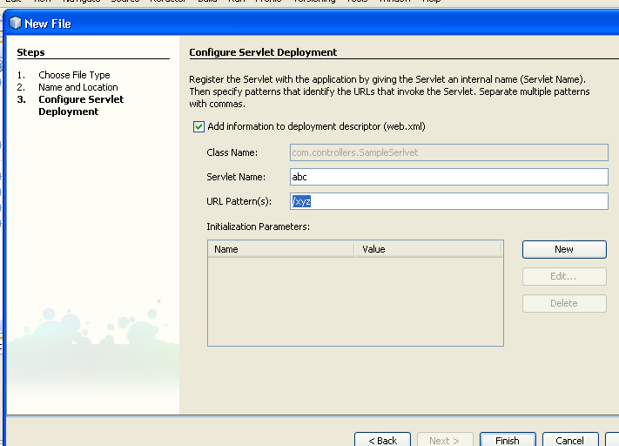
Steps for creating a new Servlet
Servlet name for deployment team
3. Specify Serlvet name, url pattern and click finsih button
Servlet name visible in the browser URL

Slide 22
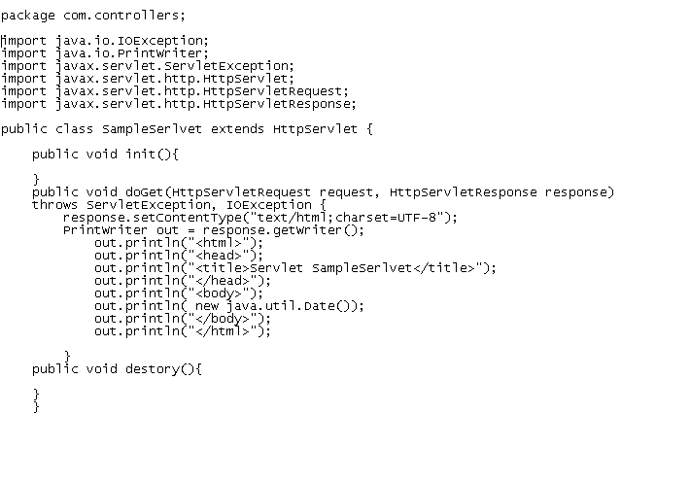
Sample Servlet Program

Slide 23
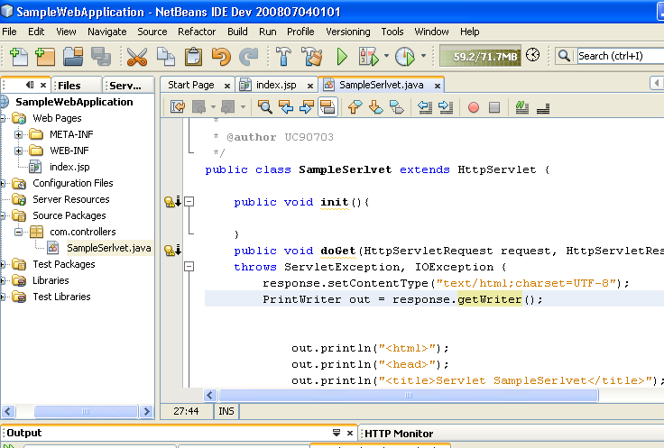
Steps for running sample servlet program
Project run button
1. Click on run button .

Slide 24
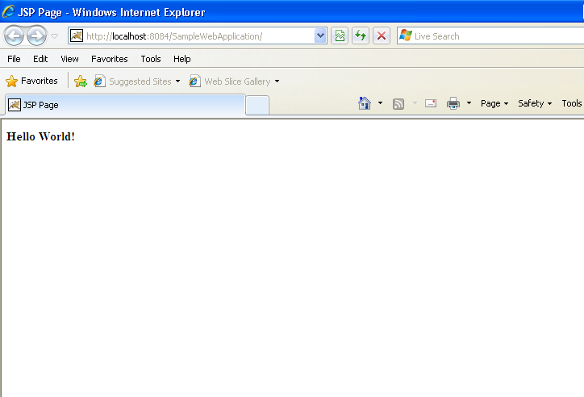
Steps for running sample servlet
Browser window will be opened and project home page( index.jsp ) page will be displayed

Slide 25
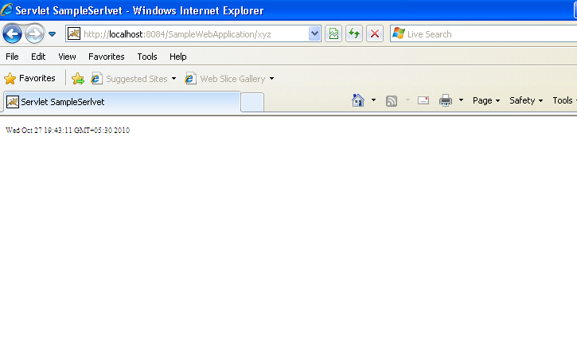
Steps for running sample servlet
2. Change the url to Sample servlet url pattern and press enter key.
HTML output returned by sample serlvlet
url pattern of sample servlet

Slide 26
Life Cycle of a Servlet
Servlet Life Cycle Methods
init()
service()
destroy()

Slide 27
Servlet Life Cycle Methods
init()
This method is called once for a servlet instance.
When first time servlet is called, servlet container creates instance of that servlet and loaded into the memory. Future requests will be served by the same instance without creating the new instance.
Servlet by default multithreaded application.
init() method is used for inilializing resources.
Ex:- Database connections, IO resources

Slide 28
Servlet Life Cycle Methods
service()
This method is called for the each request.
This is the entry point for the every servlet request and here we have to write our business logic or any other processes.
This method takes HttpServletRequest and HttpServletresponse as the parameters.
It is not mandatory to write this method, normally developers are interested in writing doGet() or doPost() methods which is by default called from the service() method.
5. When we extend GenericServlet, then we need to overide service( ) method.
6. When we extend HttpServlet, then we need to overide doGet( ) or doPost() method.

Slide 29
Servlet Life Cycle Methods
destroy()
This method will be called once for a instance.
It is used for releasing any resources used by the servlet instance. Most of the times it could be database connections, IO operations, etc.
destroy() is called by the container when it is removing the instance from the servlet container.
Servlet instance is deleted or garbage collected by the container only when the web server issues shut down or the instance is not used for a long time.

Slide 30
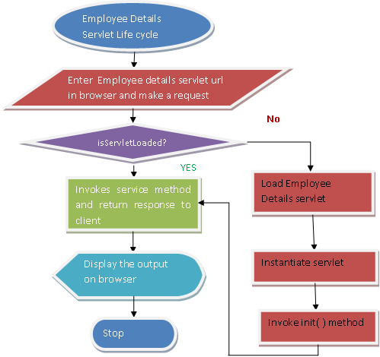
Servlet Life cycle flow chart

Slide 31
Sample program to demonstrate GET Method
Let us take a Scenario, where we have one HomePage in which we enter login credentials and submit the login form using GET method.
LoginServlet will be invoked on server side after submitting login form.
LoginServlet sends HTML page back to the client which contains the user login details.
We need two programs.
HomePage.html
LoginServlet.java

Slide 32
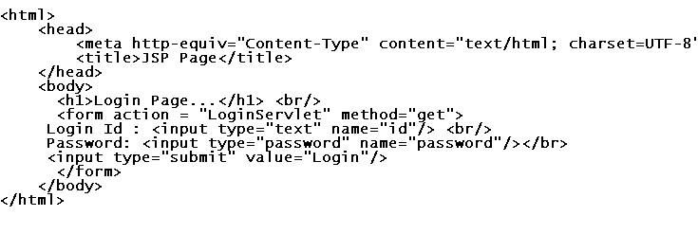
GET Method
Invoking LoginServlet using get method
url pattern of LoginServlet
HomePage.html

Slide 33
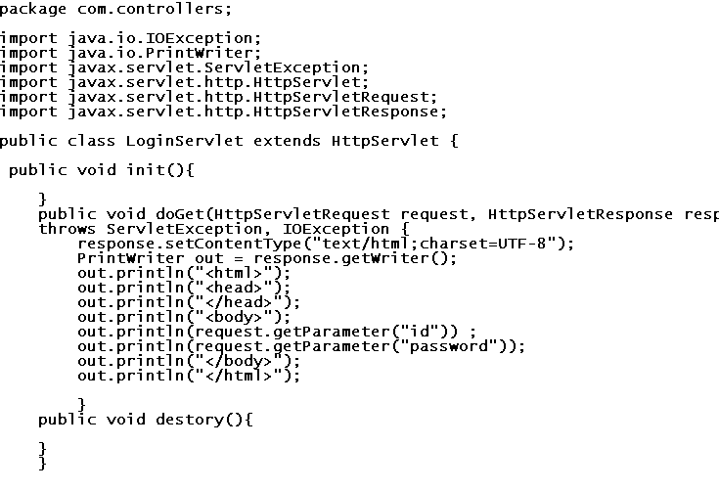
GET Method
LoginSerlvet.java
Overriding doGet() method

Slide 34
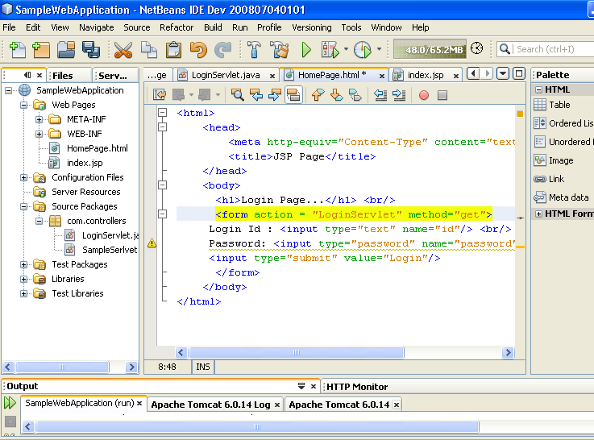
GET Method
Run the HomePage.html page pressing Shift +F6

Slide 35
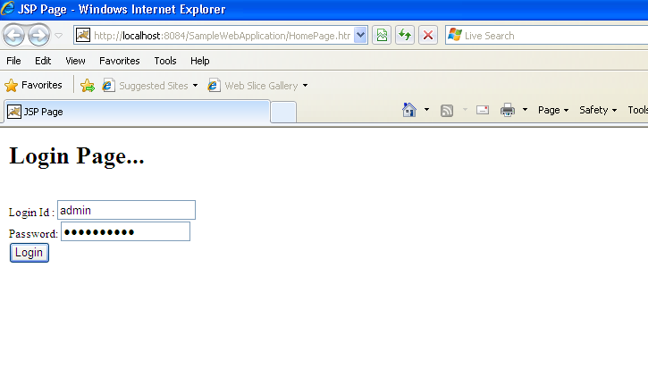
GET Method
Observe the url before clicking Login button
Enter login credentials and click login button

Slide 36
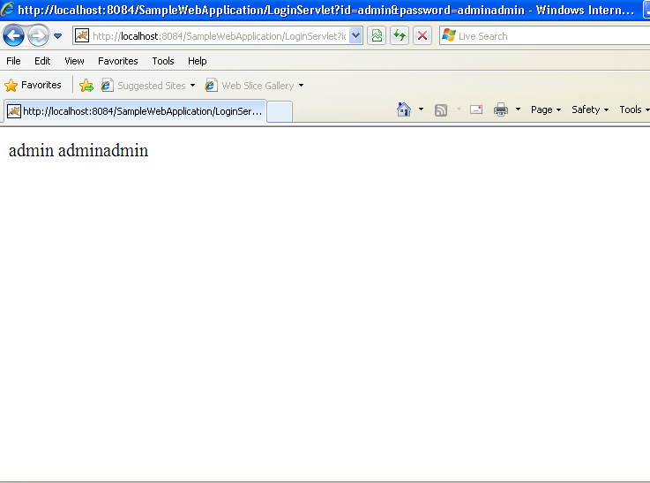
GET Method
Check the url . Form data is appended to the URL. Form Data is sent with URL

Slide 37
Sample program to demonstrate POST method
Let us take the same Scenario, where we have one HomePage in which we enter login credentials and submit the login form using POST method.
LoginServlet will be invoked on server side after submitting login form.
LoginServlet sends HTML page back to the client which contains the user login details.
We need two programs.
HomePage.html
LoginServlet.java

Slide 38
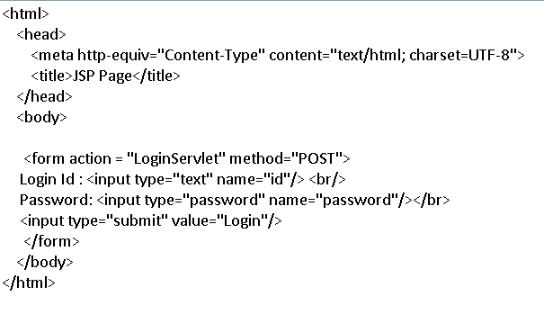
POST Method
url pattern of LoginServlet
HomePage.html
Invoking LoginServlet using POST method.

Slide 39
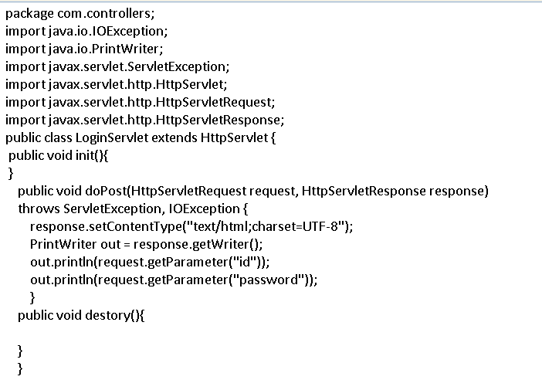
POST Method
LoginServlet.java
Overriding doPost() method

Slide 40
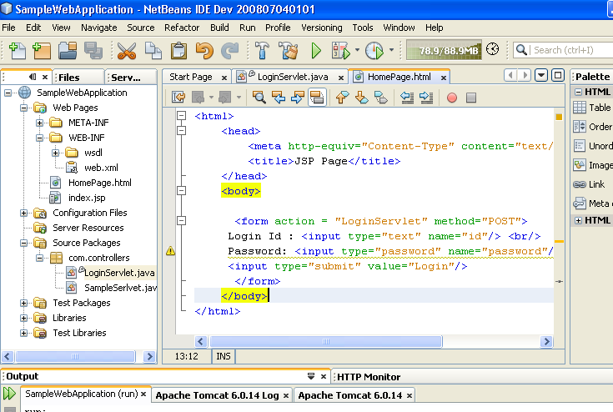
POST Method
Run the HomePage.html pressing Shift+F6.

Slide 41
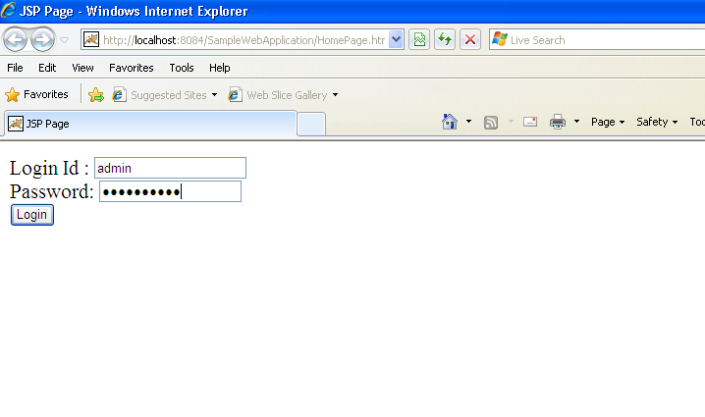
POST Method
Check the url before clicking Login button
Enter Login credentials and click Login button

Slide 42
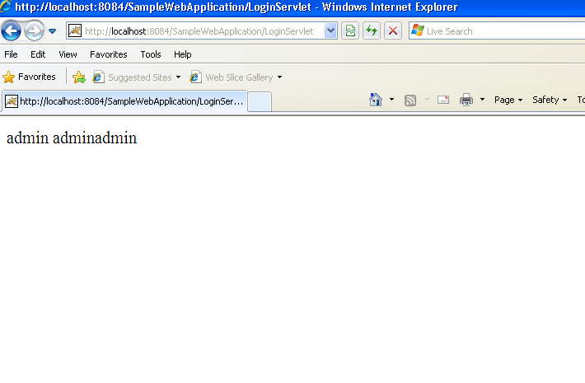
POST Method
Check the URL.Form Data is not sent with URL .Data is sent with HTTP Headers

Slide 43
GET vs POST
GET method is considered as ‘ idempotent’ method.
POST is not considered as ‘idempotent’.
Use GET for getting the things from the server.
Ex:- Downloading a file from the Server.
Use POST for posting data and changing something on server side.

Slide 44
RequestDispatcher
Request Dispatcher is used to transfer the same request to another page/servlet without user interaction.
Let us take a scenario where we have two servlets like ServletA and ServletB. We want to transfer the control from ServletA and ServletB.
We need two programs for demonstrating request dispatching.
ServletA
ServletB

Slide 45
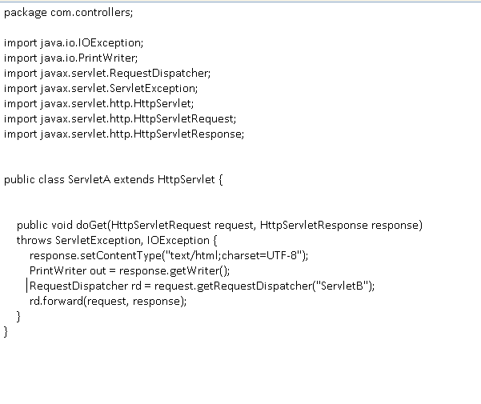
Sample program demonstrating RequestDispatching
ServletA.java
URL pattern of ServletB

Slide 46
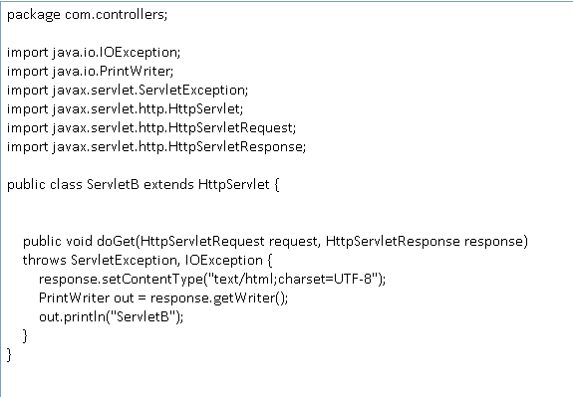
Sample program demonstrating RequestDispatching
ServletB.java

Slide 47
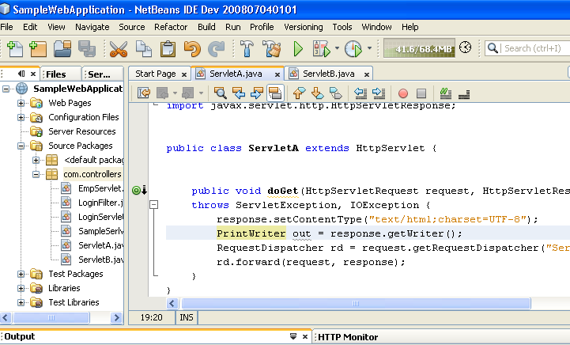
Run the Sample program
Run ServletA by pressing Shift+F6 .

Slide 48
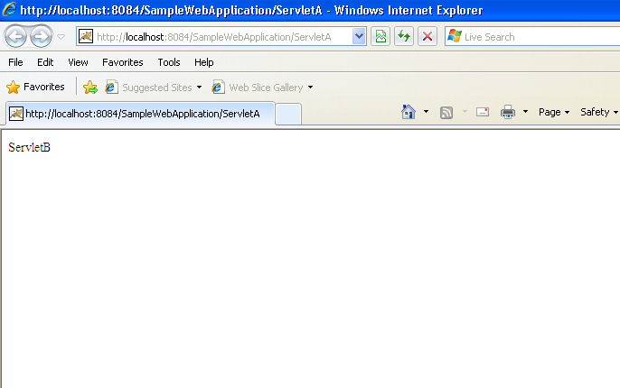
Output
Check the URL. It shows the URL of ServletA and not URL of ServletB
Output returned by ServletB

Slide 49
More about RequestDispatcher
Getting a RequestDispatcher from a ServletRequest.
RequestDispatcher rd = request.getRequestDispatcher(“result.jsp”);
The getRequestDispatcher () method in ServletRequest takes a String path for the
resource to which your are forwarding the request. If the path starts with a forward
slash(“/”), the container sees that as “starting from the root of this web app. If the path
doesn’t start with a forward slash, it’s considered relative to the original request.
path may start or may not start with a forward slash

Slide 50
More about RequestDispatcher
2. Getting the RequestDispatcher from a ServletContext.
RequestDispatcher rd = getSerlvetContext().getRequestDispatcher(“/result.jsp”)
Like the equalent method in ServletRequest, this getRequestDispatcher() method takes a String path for the resource to which your are forwarding the request, except you cannot specify a path relative to the current resource ( the one that received this request). That means you must start the path with a forward slash.

Slide 51
SingleThreadModel
SingleThreadModel is a marker interface( it doesn’t have any methods ).
If a servlet class implements SingleThreadModel interface, then only one thread can access that servlet instance at a given point of time. Servlet instance can’t be accessed simultaneously by multiple threads at a time.
Avoid implementing SingleThreadModel.

Slide 52
About sendRedirect
The source servlet calls the sendRedirect() method of the response object and sends back the response to the browser along with the status code(along with URL of destination servlet or jsp.
Then the browser sees the status code and look for that destination servlet or jsp which can now handle the request.
Again the browser makes a new request, but with the name of that destination servlet or jsp and the result will be displayed to you by the browser.
In all this process the client is unaware of the processing.

Slide 53
Sample program demonstrating sendRedirect
Let us take two servlets.
SourceServlet.java
DestinationServlet.java

Slide 54
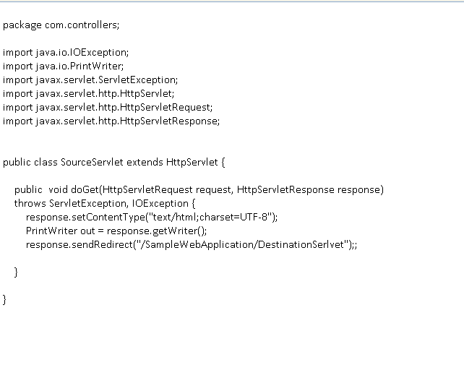
Sample program demonstrating sendRedirect
SourceSerlvet.java
URL pattern of destination servlet.
Context root of a project. We can also mention other project context root.

Slide 55
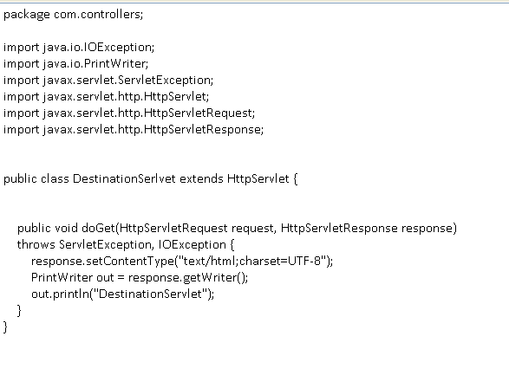
Sample program demonstrating sendRedirect
DestinationServlet.java

Slide 56
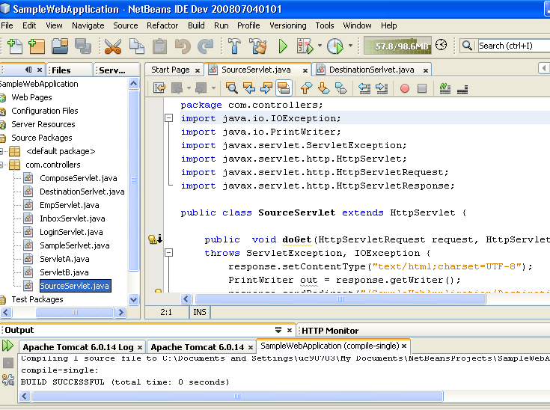
Run the Sample program demonstrating sendRedirect
Run the SourceSerlvet.java by pressing Shift+F6.

Slide 57
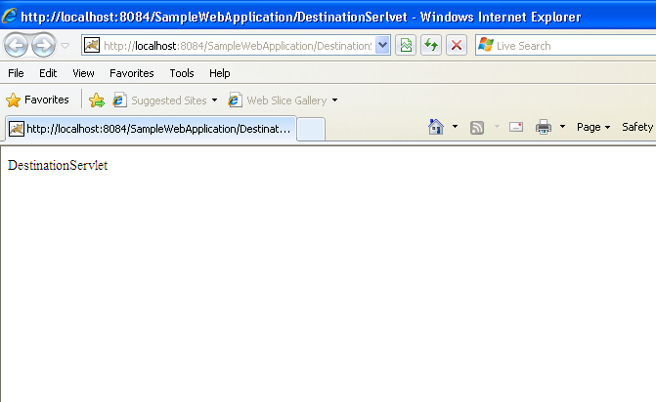
Output
Check the URL.
Observe the difference between RequestDispatching and sendRedirect. In sendRedirect URL changes to DestinationServlet
Output returned by DestinationServlet

Slide 58
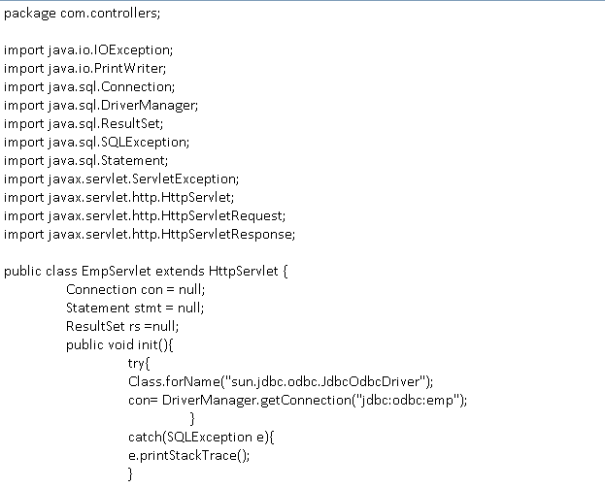
Sample Servlet displaying Employee Details

Slide 59
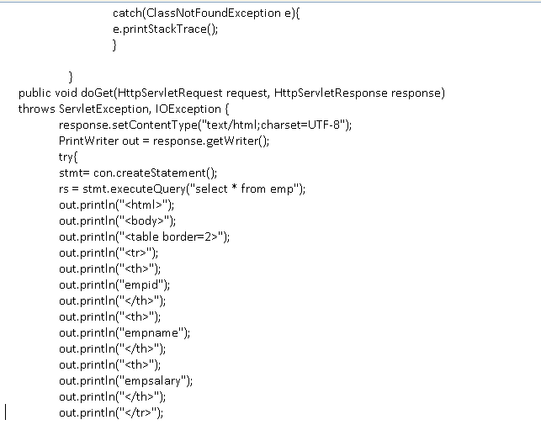
….Continuation from previous page

Slide 60
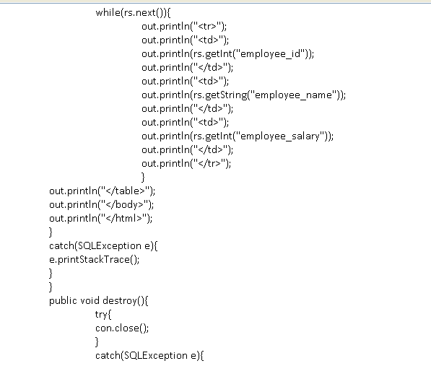
….Continuation from previous page

Slide 61
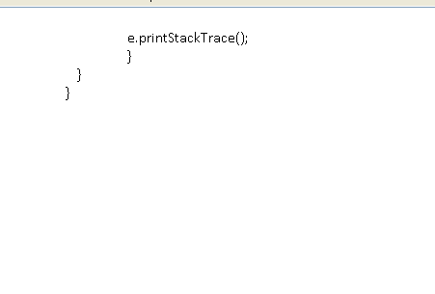
….Continuation from previous page

Slide 62
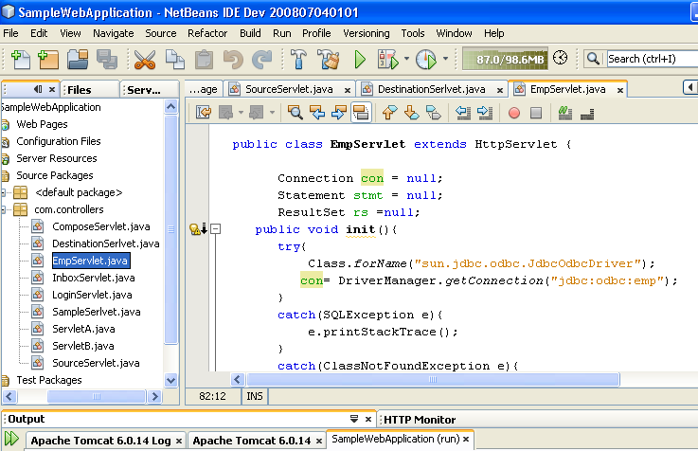
Run the Program
Run the EmpServlet by pressing Shift+F6

Slide 63
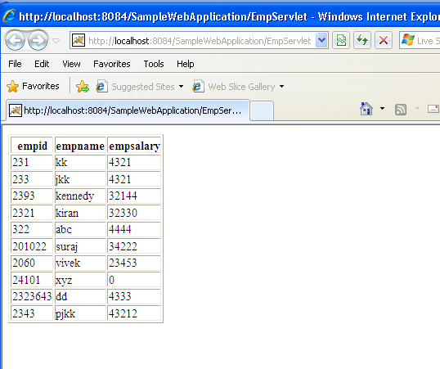
Output

Slide 64
About Deployment Descriptor (web.xml )
Servlet mapping details are configured in DD.
Filter mapping information can be configured in DD.
Home page or default page can be specified
We provide error page information .
We can pass web application parameters( as context parameter)
Servlet initialization parameters can be specified in DD.
We can specify security roles.
EJB reference details can be specified.
We specify session timeout info.

Slide 65
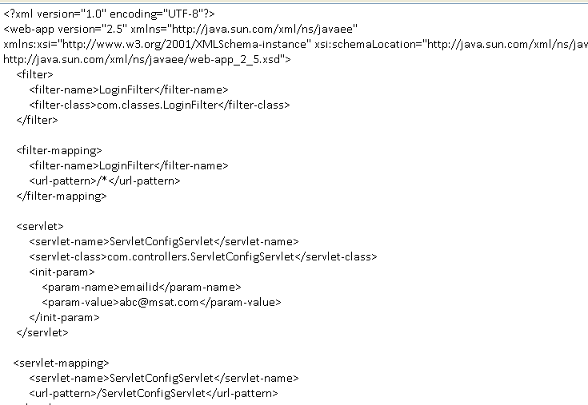
Sample web.xml

Slide 66
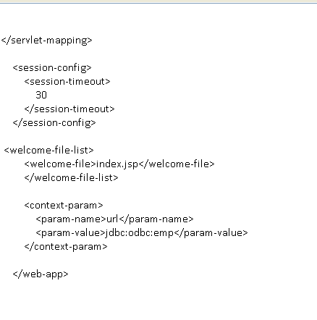
Sample web.xml

Slide 67
Thank you

